Slide 1

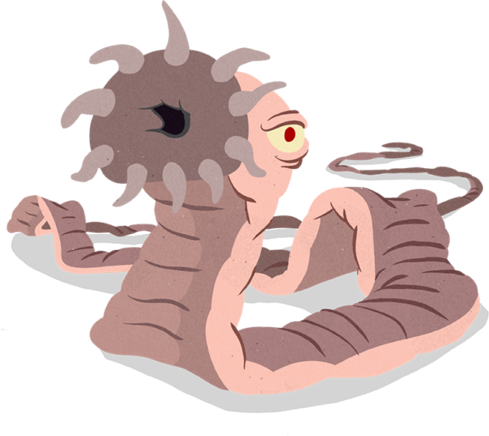

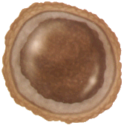







Keep your Albendazole away from my babies!
Toxocara Cati
A Neglected Zoonotic Parasite and Public Health Concern
Goo - goo.
Sienna Meneses
Yo San University
Principles of Public Health

Slide 2


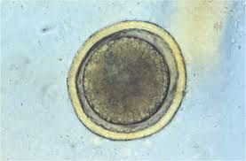
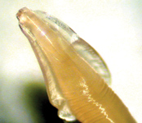
TAXONOMY BACKGROUND
Toxocara cati, also known as the feline roundworm, is parasite of cats and other felids.
  It is one of the most common nematodes of cats, infecting both wild and domestic felids worldwide.
Egg
Adult
Meow.

Slide 3

Burden of challenge.
• 25–30% of cats infected worldwide
• 14% human exposure in the U.S.
• ~700 ocular toxocariasis cases per year
• Eggs survive years in soil

Slide 4



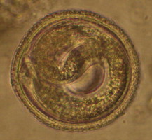
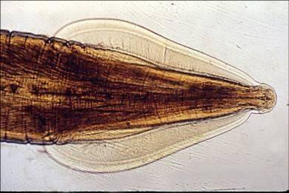
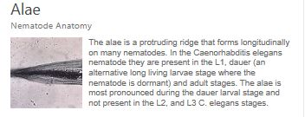
Identification of Parasite
Hey, class,
I think I found something!
Feline roundworms are brownish-yellow to cream colored to pink and may be up to 10 cm in length. Adults have short, wide cervical alae giving their anterior ends the appearance of an arrow (hence their name, toxo, meaning arrow, and cara meaning head). Eggs are pitted ovals with a width of 65 μm (micrometers) and a length of about 75 μm making them invisible to the human eye.
Yes, you did! It’s toxocara cati!
*
Egg
Adult
*

Slide 5
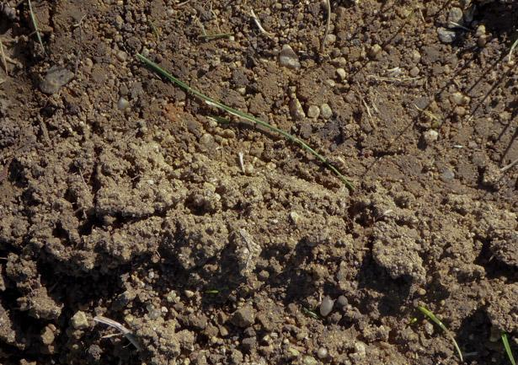


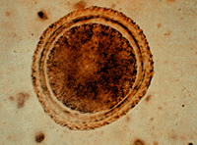
Toxocara Cati
February, 2019
Toxocara Cati
March, 2019

Slide 6

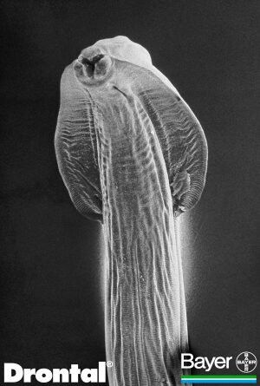
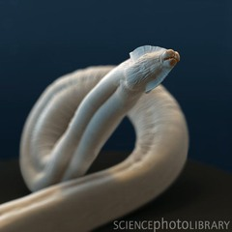
Toxocara Cati
March, 2019
Toxocara Cati
April, 2019

Slide 7

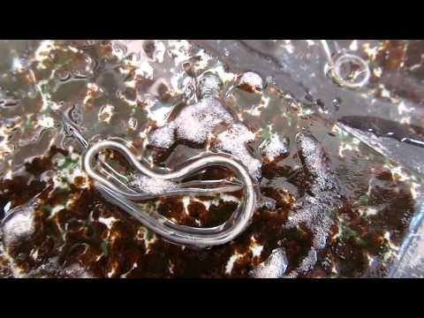





Toxocara Cati in motion

Slide 8


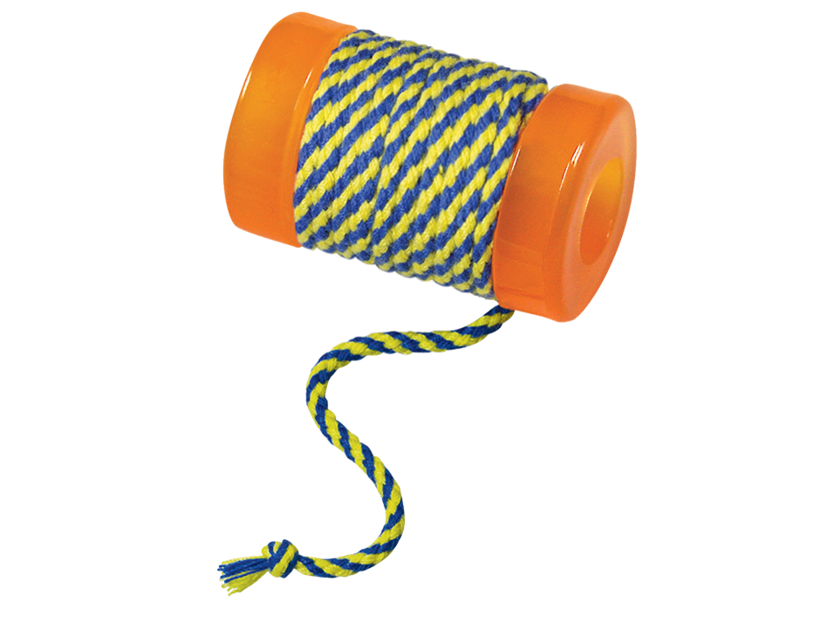


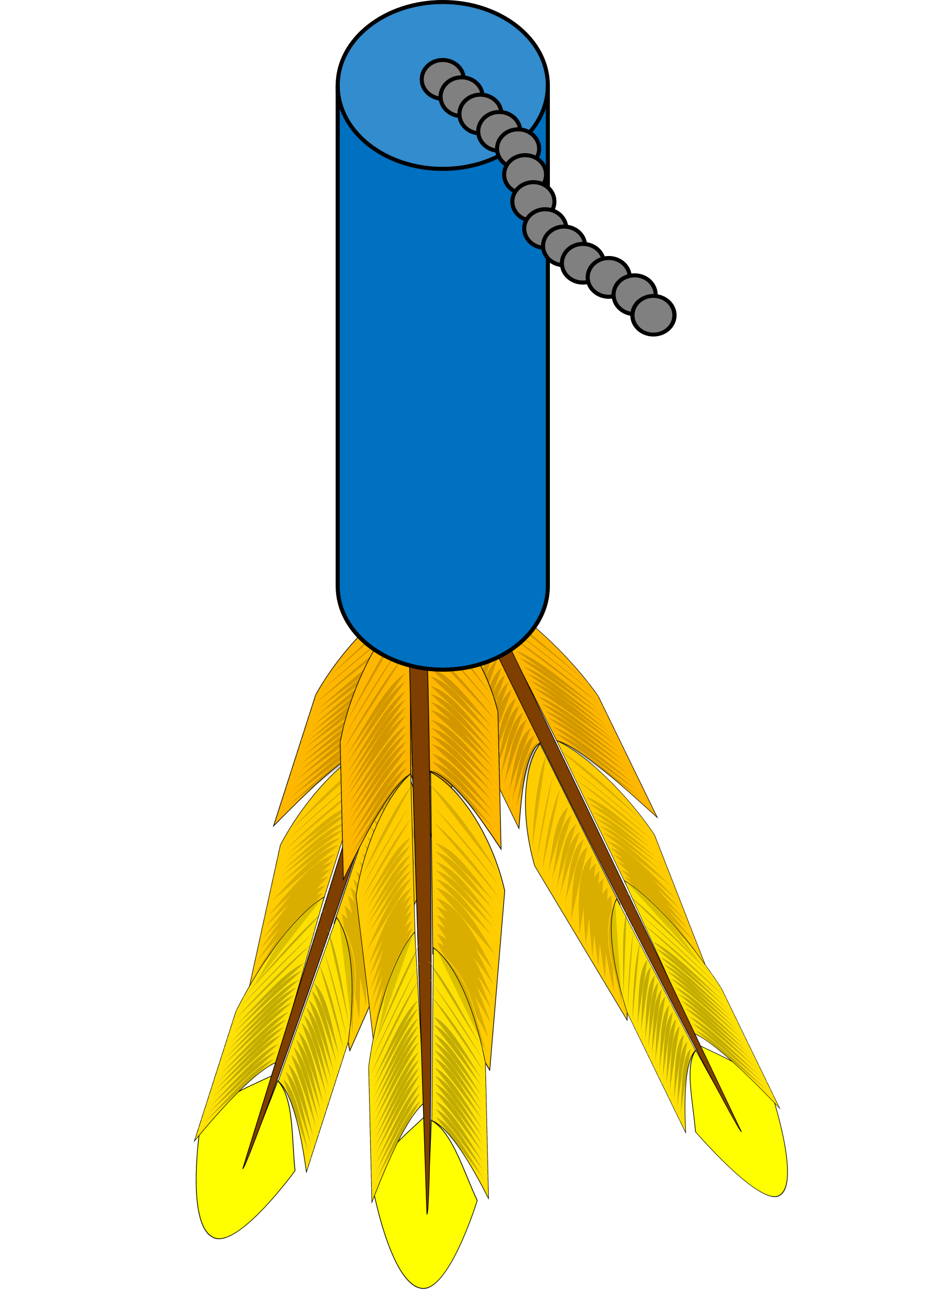

Public Health Implications
Zoonotic potential!
The definitive host (meaning the host that the disease wants to be in) is the domestic cat, in which they live as adults within the lumen of the small intestine.

Slide 9

Public Health Implications: Transmission
Fecal-oral route. Ingestion of infected prey. Eating of eggs.
Ingestion of the embryonated eggs of Toxocara initiates infection in the definitive and aberrant host.
Toxocara cati is transmitted from animals to humans (not human-to-human)
• Infection occurs through ingestion of embryonated eggs from contaminated soil or surfaces

Slide 10
Public Health Implications
At-Risk Populations
Children (especially in playgrounds and sandboxes)
Pet owners and individuals with frequent soil exposure
Immunocompromised individuals
Environmental Persistence
Eggs can survive in soil for years, making eradication difficult
Contamination of public spaces (parks, sandboxes) increases exposure risk
Health Impact
Often asymptomatic → contributes to underdiagnosis
Can cause ocular toxocariasis → vision loss (~700 cases/year in U.S.)
Larval migration may affect liver, lungs, and other organs
Epidemiological Significance
Approximately 14% of people in the U.S. have been exposed
Represents a neglected but widespread zoonotic infection
Health Disparities
Higher risk in communities with limited access to veterinary care and sanitation
Stray/untreated animal populations increase environmental contamination
Preventable, yet persistent due to environmental durability and gaps in public awareness

Slide 11
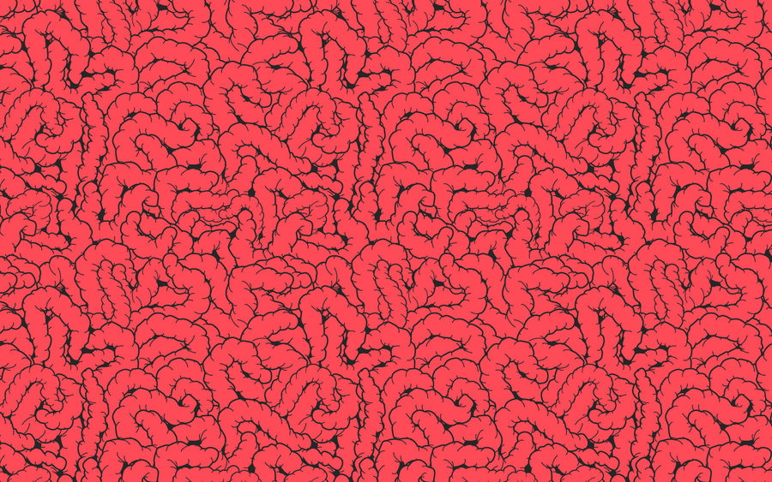
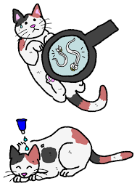

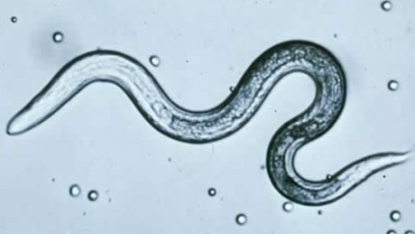
Life Cycle of Toxocara Cati
The adult worms live in the small intestine and the eggs are passed in the feces of the cat, into the soil (in which it can live for several years).
The egg passed contains a single cell, and after a period of time in the environment, two molts occur within the eggshell.
  Infective larvae produced.
Larvae move away from the GI tract and travel to other organs before commencing development.
*
*Molts: shedding succession to make way for new growth.

Slide 12

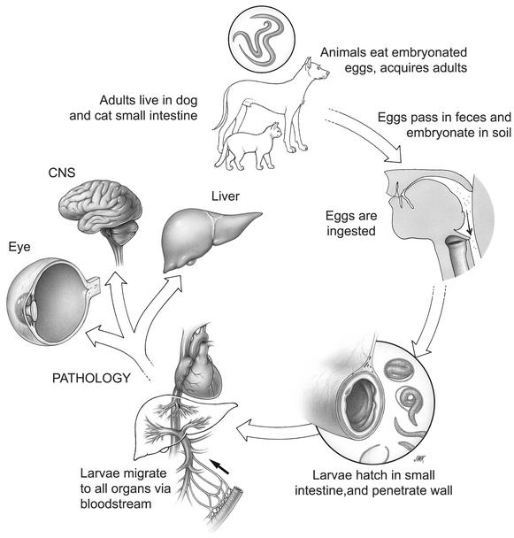
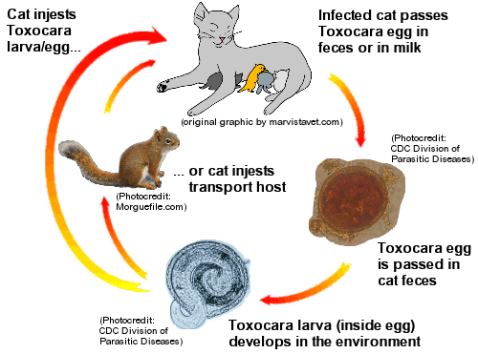
Human Infection
Cat Infection
Toxocara Cati Life Cycle, Continued...

Slide 13
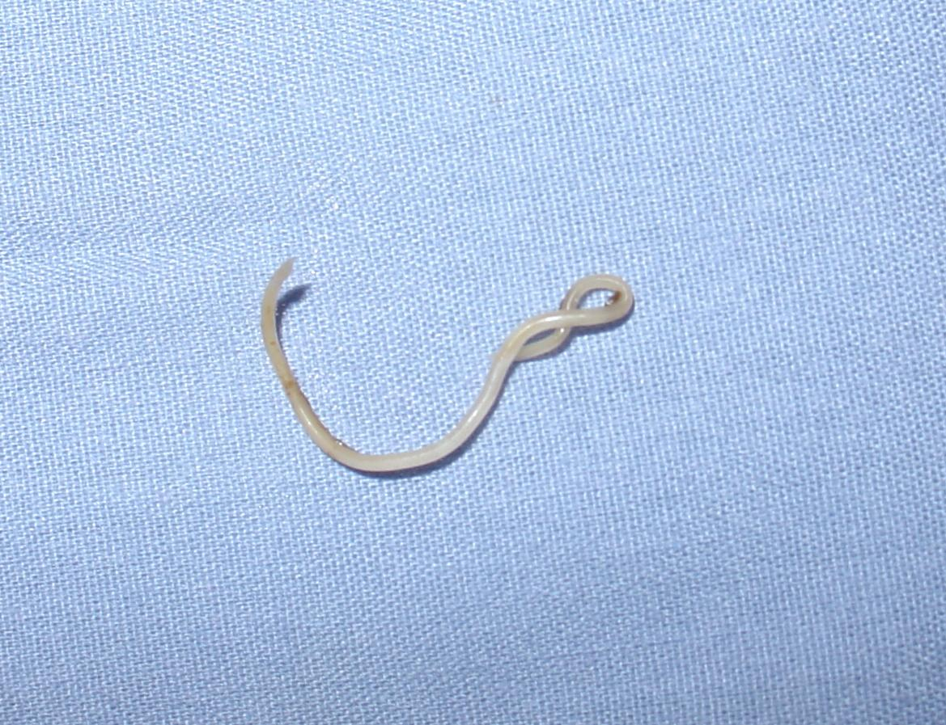

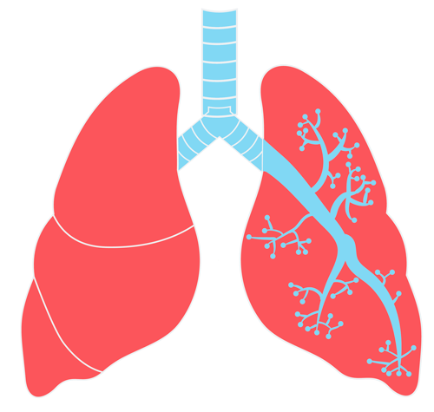

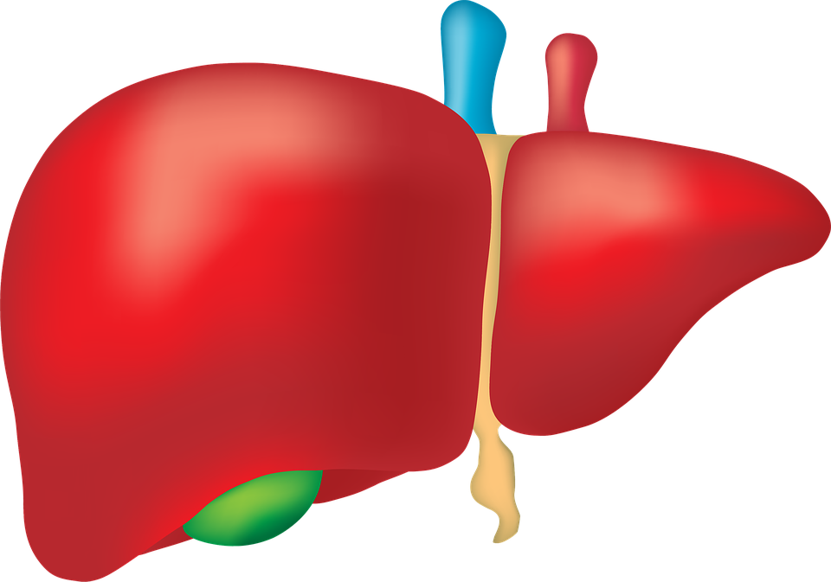



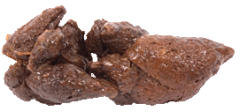
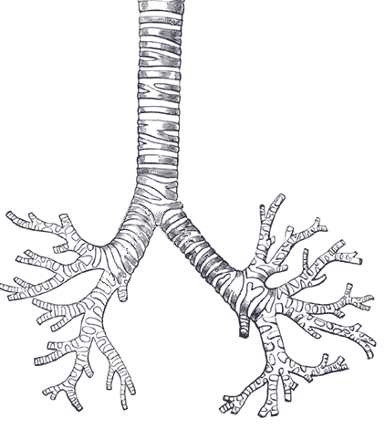
3, 5, 10, 56
DAYS LATER
By three days after infection, larvae found in:
  liver, lungs, and stomach wall.
Five days after infection, larvae in the:
  lungs, tracheal washings, and stomach wall.
Tenth day of infection:
  many larvae in the lungs and stomach wall, and a # of larvae in muscle tissues.
Eggs first observed in:
  feces, beginning 56 days after the infection.
Link:
https://vib.by/v/mJjtsKu4v/

Slide 14

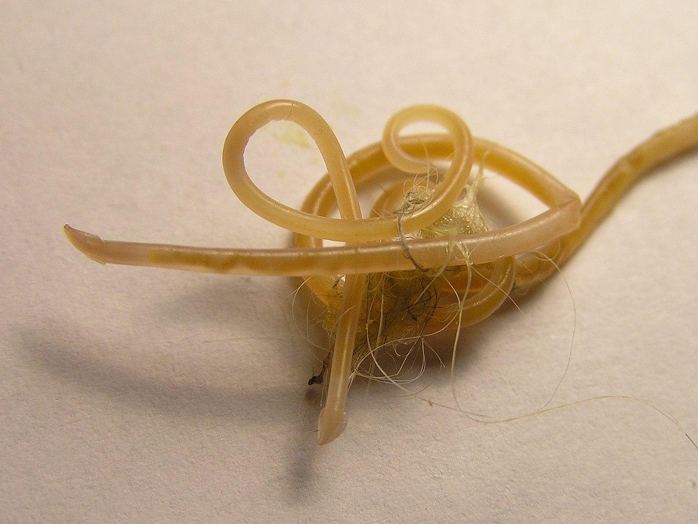
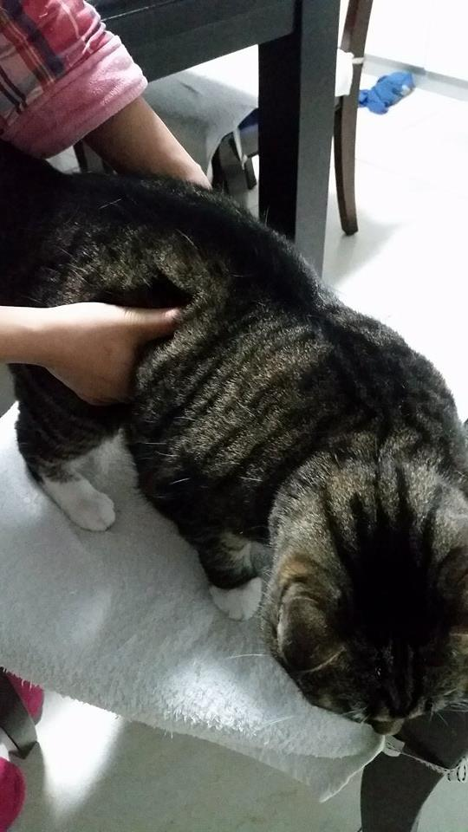
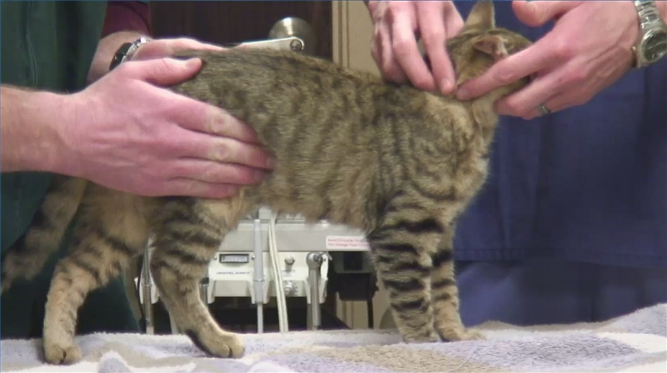
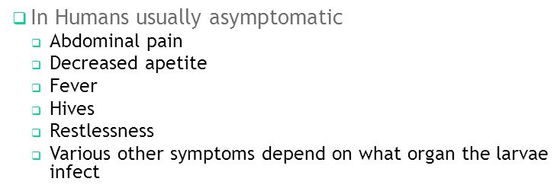
Clinical Signs
In adult cats, the infection is usually asymptomatic.
  However, massive infection in juvenile cats can be fatal.
    Symptoms:.
      Pot-bellied appearance and a general failure to thrive.
      On occasion, it may be possible to palpate thickened intestines.
Palpation of Abdominal Region

Slide 15

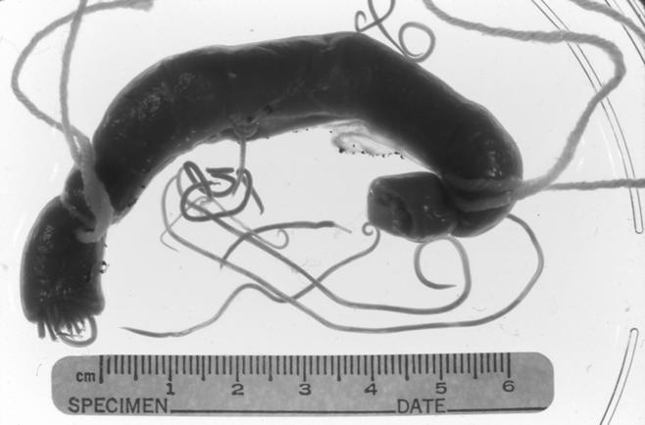
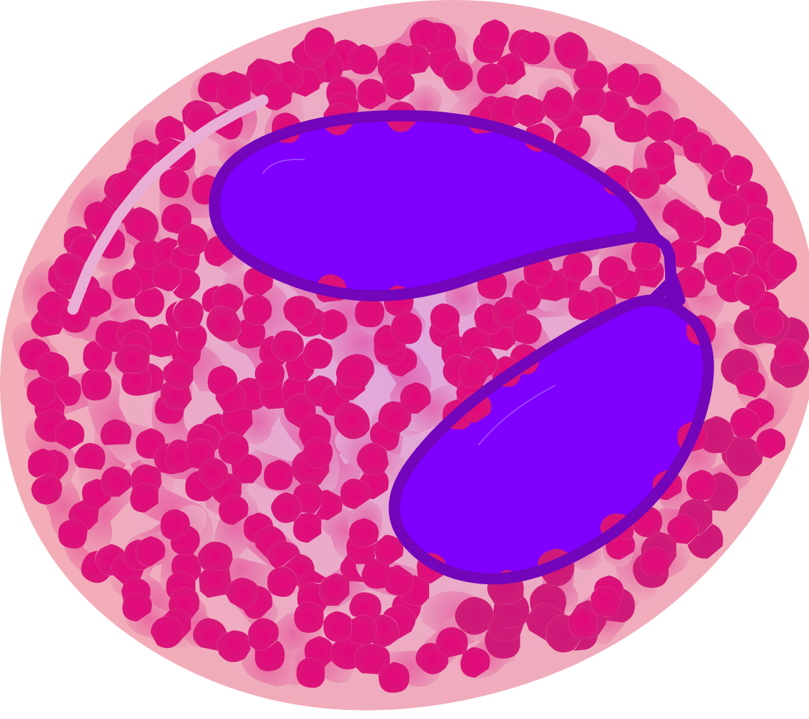
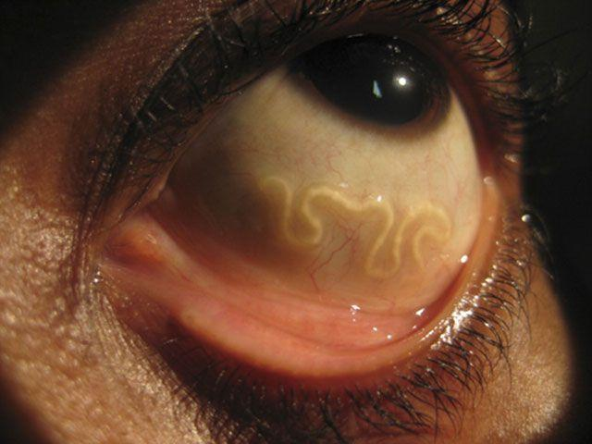
Diagnosis
Histopathological sections of tissues obtained at biopsy show T. cati larvae.
High circulating eosinophilia.
Juveniles of parasite species detected in a variety of lesions of the eye and throughout the body.
Larvae in feces/identified in fecal exam.
Worms in small intestine/other organs at necropsy.
Elisa snap test
Portion of small intestine with adult worm.
Male worms have a curled tail; females have a straight tail.
Ocular larva migrans (OLM), also known as ocular toxocariasis, is the ocular form of the larva migrans syndrome that occurs when Toxocara cati larvae invade the eye.

Slide 16




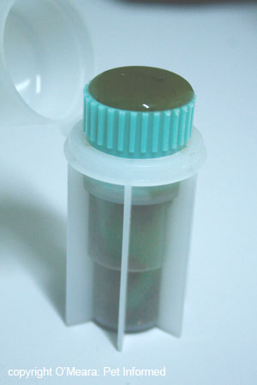
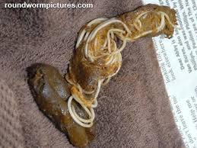
Fecal Tests
Fecals are an important part of your pet’s annual exam.
The Centers for Disease Control (CDC) says that 14% of people in the U.S. have been infected with the roundworm toxocara.
  Approximately 700 people lose vision every year.
Fecals are an important tool to ensure that your pet and your household are not infected and exposed to intestinal parasites, respectively.
Because intestinal parasites live in your pet’s gastrointestinal tract, they are usually hidden from view. Unlike external parasites like fleas and ticks, most intestinal parasites are never seen.
  According to the Companion Animal Parasite Council, more than 25% of cats are infected.

Slide 17

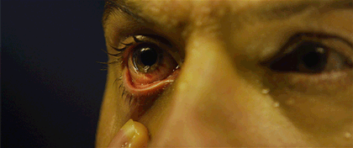

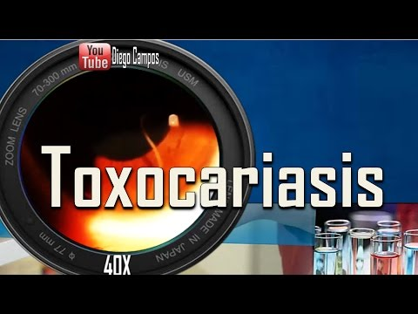
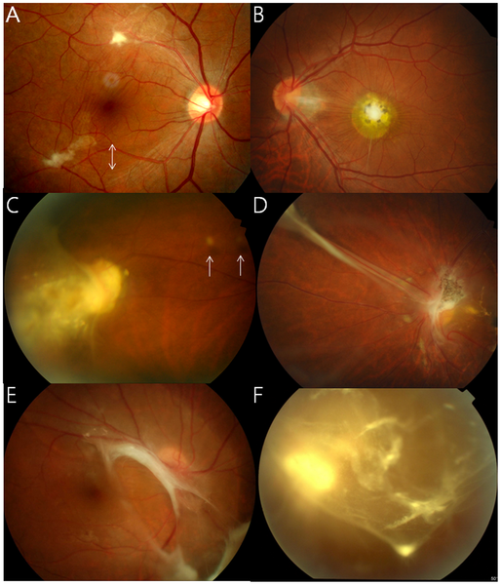
Ocular larva migrans
Prometheus Movie Clip
Toxocara In the Eye

Slide 18

Current and Proposed Role of Acupuncture / TCM
Evidence is limited, but TCM may help with symptom management and immune modulation.
Potential roles:
1. Immune regulation
Acupuncture research shows modulation of:
• inflammatory cytokines
• immune response pathways
2. Gastrointestinal symptom relief
Acupuncture has evidence for:
• abdominal pain
• diarrhea
• digestive regulation
Example points often used for GI regulation:
• ST36 (Zusanli)
• CV12 (Zhongwan)
• SP6 (Sanyinjiao)
3. Integrative care
TCM could serve as adjunctive therapy alongside antiparasitic medication, not a replacement.

Slide 19
Location of Points for Humans and Animals
Stomach Channel: ST36 (Zusanli)
Located on the anterior aspect of the leg, 3 cun below ST35 and one finger-breadth lateral to the tibial crest (in animals: cranial aspect of the hind limb, distal to the stifle joint). This point tonifies Qi and Blood, supports digestion, immune function, and fatigue, and has grounding effects.
Spleen Channel: SP6 (Sanyinjiao)
Located on the medial aspect of the leg, 3 cun above the medial malleolus, posterior to the tibia (in animals: medial hind limb, proximal to the tarsus). This point regulates menstruation, digestion, and immune function, and is the crossing point of the three Yin channels.
Conception Vessel: CV12 (Zhongwan)
Located on the anterior midline, 4 cun above the umbilicus (in animals: ventral midline of the abdomen, between sternum and umbilicus). This point harmonizes the Stomach and intestines and is the Front-Mu point of the Stomach.

Slide 20
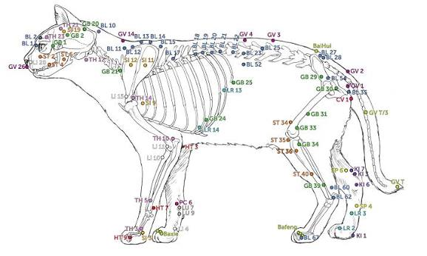
CV12•

Slide 21
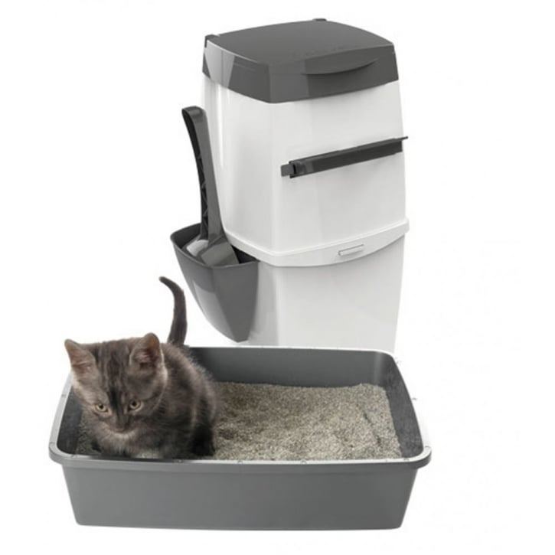
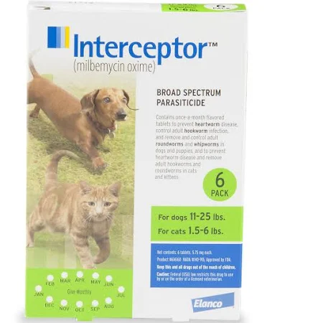

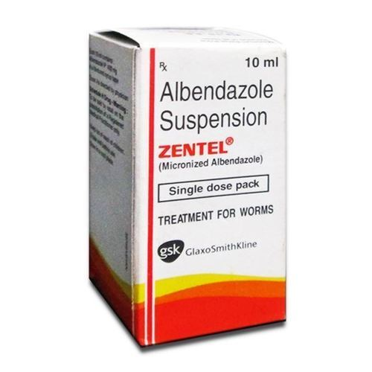
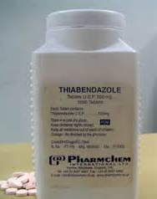

Mitigation: Prevention and Treatment
Daily disposal of feces before sporulation.
Preventing access to cat feces.
Food utensils should be kept species-specific.
Sanitation or replacement of housing, utensils, and other environmental items.
Environmental eradication may be attempted.
Avoid feeding uncooked meat or meat by-products.
Do not allow cats to eat prey (mice, rats, rabbits).
Keep cat feces from contaminating foods, litter boxes, and housing areas.
Anthelmintics: albendazole, thiabendazole and mebendazole may be given with anti-inflammatory corticosteroids.

Slide 22

Deworming for cats
A suitable protocol for worm treatment for cats of all ages is:
Kittens 2 weeks - 3 months: 0.5 worming tablets every 2 weeks
Kittens 3 months – 6 months: 1 worming tablet once monthly
Kittens/cats 6 months +: 1 worming tablet every 3 months
Drontal Allwormer dose for cats & kittens:
1 worming tablet per 2 to 4 kg body weight
1 worming tablet for large cats per 6 kg body weight
Always ask your veterinarian (DVM), for proper medical advice.

Slide 23

Limitations and Challenges
Major barriers:
1. Underdiagnosis
Many infections are subclinical.
2. Limited TCM research
There are very few clinical studies examining acupuncture specifically for parasitic infections.
3. Environmental persistence
Even with treatment, eggs remain in soil.
4. Public awareness
Many people are unaware that cat feces can transmit zoonotic parasites.

Slide 24

Conclusions / Recommendations
Key takeaways: • Toxocara cati is a neglected zoonotic parasite with environmental transmission • Prevention depends on veterinary care, sanitation, and public education • Integrative medicine approaches like acupuncture may help manage symptoms and inflammation • More research is needed on TCM’s role in immune modulation in parasitic disease Improving awareness among pet owners, healthcare providers, and veterinarians could significantly reduce exposure. Questions? Comments? Concerns?

Slide 25

Works Cited
“Toxocara Cati.” American Association of Veterinary Parasitologists, www.aavp.org/wiki/nematodes/ascaridida/toxocara-cati/.
“Parasites - Toxocariasis (Also Known as Roundworm Infection).” Centers for Disease Control and Prevention, Centers for Disease Control and Prevention, 10 Jan. 2013, www.cdc.gov/parasites/toxocariasis/index.html.
Zibaei, Mohammad, et al. “Toxocara Cati Larvae in the Eye of a Child: a Case Report.” Asian Pacific Journal of Tropical Biomedicine, Asian Pacific Tropical Medicine Press, May 2014, www.ncbi.nlm.nih.gov/pmc/articles/PMC4025287/.
Xie, H., & Preast, V. (2013). Xie’s veterinary acupuncture (2nd ed.). Wiley-Blackwell.
Schoen, A. M. (2001). Veterinary acupuncture: Ancient art to modern medicine (2nd ed.). Mosby.
Deadman, P., Al-Khafaji, M., & Baker, K. (2007). A manual of acupuncture. Journal of Chinese Medicine Publications.
Langevin, H. M., & Yandow, J. A. (2002). Relationship of acupuncture points and meridians to connective tissue planes. The Anatomical Record, 269(6), 257–265. https://doi.org/10.1002/ar.10185
“Parasites - Toxocariasis (Also Known as Roundworm Infection).” Centers for Disease Control and Prevention, Centers for Disease Control and Prevention, 10 Jan. 2013, www.cdc.gov/parasites/toxocariasis/gen_info/faqs.html.

